Slide 1
Lesson 06 Matrices and Row Operations
Interactive Seminar Slides
E114 – Mathematics for Engineering

Slide 2
Scenario
An RP student just returned from a Student overseas trip from cities Xebia, Yeeta and Zortia. The amount of money that he spent each day on housing, food and miscellaneous expenses in each city are shown in the table below:
The student’s records for his trips show that he has spent a total of $420 on housing, $440 on food, and $180 on miscellaneous expenses.
Country | Amount spent on housing ($) | Amount spent on food ($) | Miscellaneous Expenses ($)
Xebia | 30 | 30 | 10
Yeeta | 20 | 30 | 10
Zortia | 20 | 20 | 10

Slide 3
Scenario
Let x, y and z represent the number of days that the student spent in cities Xebia, Yeeta and Zortia respectively.
The information provided can be expressed as a system of 3 linear equations in 3 variables:
Explore the use of matrices to solve a system of linear equations in a certain number of variables, such as the one shown above.
Hence, solve for x, y and z$.$

Slide 4
Scenario Definition Template
What We Know:
Amount the traveller spent each day on housing, food and miscellaneous expenses in Countries Xebia, Yeeta and Zortia
Total amount the traveller spent on housing, food and miscellaneous expenses
Definitions of variables x, y and z
The system of 3 linear equations representing the data
To solve the equations for x, y and z
What We Don’t Know:
What is a linear equation?
How to express a system of these equations in matrix form?
What are the properties of matrices?
How to carry out matrix operations to solve the matrix equation?
What We Need to Find Out:
Definition of a linear equation and a system of linear equations
How to express system of linear equations in matrix form
Techniques to solve matrix equations

Slide 5
Lesson Overview
S/N | Concepts | Slide Number
1 | Linear Equation in n Variables | 6
2 | A System of Linear Equations | 7
3 | Expressing a System of Linear Equations in Matrix Form | 8-10
4 | Determinant and Inverse of a 2 x 2 Matrix | 11-13
5 | Identity Matrix | 14-15
6 | Solving 2 x 2 Matrix Using Inverse Matrix | 16-17
7 | Row Echelon Matrix | 19-21
8 | Elementary Row Operations (EROs) | 22-27
9 | Application of EROs: Matrix Operations | 28-34
10 | Solving a System of Linear Equations Using Elementary Row Operations (CL) | 35-41

Slide 6
Linear Equation in $n$Variables
A linear equation in n variables x₁, x₂, x₃, …, x_{n} has the form
𝑎₁𝑥₁ + 𝑎₂𝑥₂₊ 𝑎₃𝑥_{3+…+} 𝑎_{n}𝑥_{n} = b.
The coefficients a₁, a₂, a₃, …, a_{n} are real numbers, and the constant term b is also a real number.
Note:- Linear equations do not contain products or roots of variables.
- The variables also are not involved in trigonometric, exponential or logarithmic functions.
- Variables appear only to the first power.
[Example 1]
The equations below are linear:
3𝑥+2𝑦=10 (linear equation in 2 variables x and y )
0.5𝑥+𝑦+3π𝑧=√5 ( (linear equation in 3 variables x, y and z)
(sin π/2)𝑥₁−4𝑥₂+10𝑥₃−𝑥₄=0 (linear equation in 4 variables 𝑥₁,𝑥₂,𝑥₃,𝑥₄)
Reason: Equation contains a product term of 2 variables x and y
[Example 2]
The equations below are not linear:
2xy + z =3
e^{x}−5y=10
sin(𝑥₁ )+0.5𝑥₂−𝑥₃=0
Reason: Equation contains an exponential term including a variable x
Reason: Equation contains a trigonometric term including a variable x₁

Slide 7
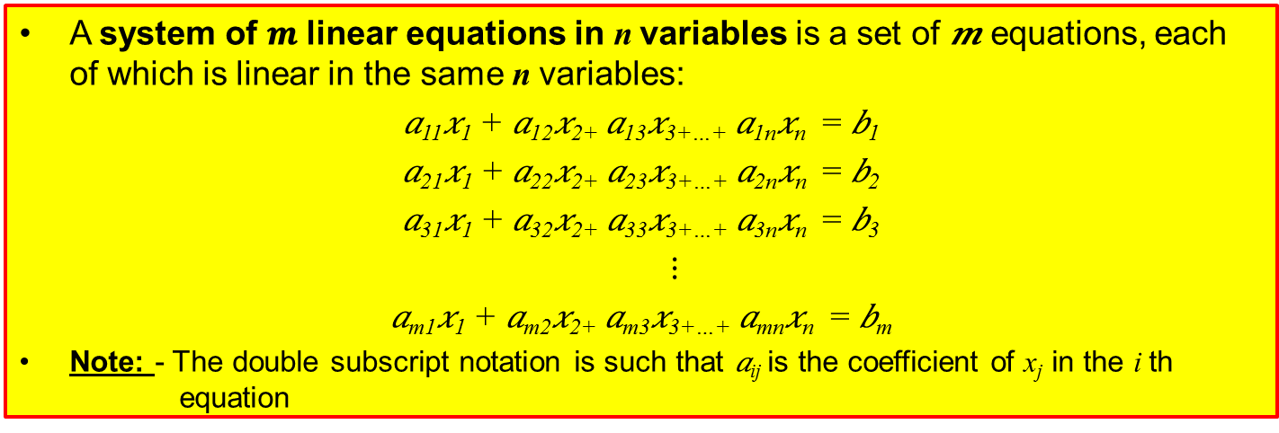
A System of Linear Equations
A system of 𝒎 linear equations in n variables is a set of 𝒎 equations, each of which is linear in the same n variables:
𝑎₁₁𝑥₁ + 𝑎₁₂𝑥₂₊ 𝑎₁₃𝑥_{3+…+} 𝑎_{1n}𝑥_{n} = 𝑏₁
𝑎₂₁𝑥₁ + 𝑎₂₂𝑥₂₊ 𝑎₂₃𝑥_{3+…+} 𝑎_{2n}𝑥_{n} = 𝑏₂
𝑎₃₁𝑥₁ + 𝑎₃₂𝑥₂₊ 𝑎₃₃𝑥_{3+…+} 𝑎_{3n}𝑥_{n} = 𝑏₃
$⋮$
𝑎_{m1}𝑥₁ + 𝑎_{m2}𝑥₂₊ 𝑎_{m3}𝑥_{3+…+} 𝑎_{mn}𝑥_{n} = 𝑏_{m}
Note: - The double subscript notation is such that 𝑎_{ij} is the coefficient of x_{j} in the i th equation
[Example 3]
This is a system of 2 linear equations in 3 variables:
3𝑥+2𝑦−5𝑧=1
−𝑥+𝑦+2𝑧=2
This is a system of 3 linear equations in 3 variables:
𝑥₁+𝑥₂+𝑥₃=9
2𝑥₁+3𝑥₂+𝑥₃=18
𝑥₁−𝑥₂+5𝑥₃=15

Slide 8
Expressing a System of Linear Equations in Matrix Form
A system of m linear equations in n variables can be compactly represented using a matrix.
[Example 4]
Consider the following system of 3 linear equations in 3 variables:
𝑥−2𝑦+3𝑧 =9
3𝑦−𝑥 =−4
2𝑥−5𝑦+5𝑧 =17
First, check that the order of appearance of the variables in each linear equation is the same. If not, rearrange the terms in the linear equation:
𝑥−2𝑦+3𝑧 =9
−𝑥+3𝑦+0𝑧 =−4
2𝑥−5𝑦+5𝑧 =17
`
A system of linear equations with the variables sorted.
Next, convert the system of linear equations in the matrix form:
Equivalent matrix form for the system of linear equations
It is usually more convenient to use the augmented matrix:

Slide 9

Test yourself:
Representing Data Using Matrices
A store sells red, yellow and blue shirts in three sizes: small, medium and large. The unit selling price (regardless of colour) is $x for a small-sized shirt, $y for a medium-sized shirt, and $z for a large-sized shirt. The table shows the number of shirts sold in a day.
Colour of Shirt | Quantity of Small Sizes Sold | Quantity of Medium Sizes Sold | Quantity of Large Sizes Sold
Red | 2 | 0 | 3
Yellow | 4 | 5 | 7
Blue | 3 | 5 | 1
The total income from the sale of the red shirts was $26, yellow shirts $98, and blue shirts $58.
Represent the given data in the matrix form.

Slide 10
Test yourself:
Representing Data Using Matrices

Slide 11
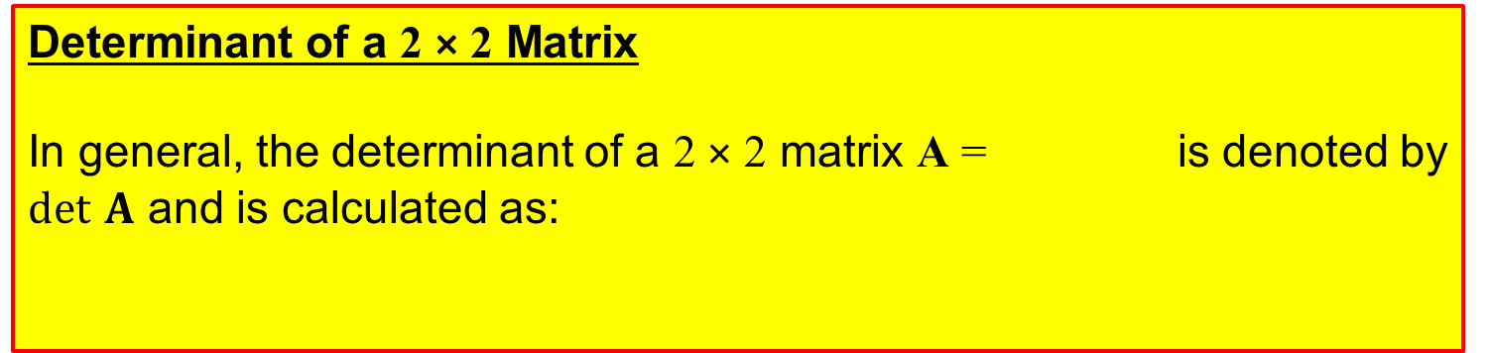
Determinant and Inverse of a 2 × 2 Matrix
Determinant of a 2 × 2 Matrix
In general, the determinant of a 2 × 2 matrix A = is denoted by $det$ $A$ and is calculated as:
det A = a × d – b × c
Inverse of a 2 × 2 Matrix
In general, the inverse of a 2 × 2 matrix A = is denoted by A⁻¹ and is calculated as:
Note:
A matrix that does not have an inverse is called a “singular matrix”.
For a singular matrix, its determinant = 0.
A matrix that has an inverse is called a “non-singular matrix”.

Slide 12
Determinant and Inverse of a 2 × 2 Matrix
[Example 9]
Find the determinant and inverse of a 2 × 2 matrix A = .
[Solution]
det A = (−1)(4) − (5)(−2)
= (−1)(4) + (5)(−2)
= − 4 + 10
= 6
Is this correct?
Notes:
C

Slide 13
Test yourself: Determinant and Inverse of a 2 × 2 Matrix
Find the inverse of the following 2 × 2 matrices:
A =
B =

Slide 14
Identity Matrix
The identity matrix I_{n} is a square matrix, in other words an n × n matrix, with entries “1” along the diagonal from upper left to lower right and “0” in all other positions.

Slide 15
Identity Matrix
Multiplying any square matrix M with its inverse matrix M⁻¹ will return the identity matrix I:
MM⁻¹ = I
M⁻¹M = I
Multiplying any matrix M with the identity matrix I will return the same matrix M, just like multiplying any number with 1 will return the same number:
MI = M
IM = M
Post-multiply M by M⁻¹
Pre-multiply M by M⁻¹

Slide 16

Solving 2 × 2 Matrix Equations
Using Inverse Matrix
The inverse matrix can be used to solve matrix equations.
Starting Equation: MX = Y
Pre-multiply M⁻¹ on both sides: M⁻¹MX = M⁻¹Y
IX = M⁻¹Y
X = M⁻¹Y
[Example 10] Given that , find x and y.
matrix M
M⁻¹
M⁻¹
$∴$ x = 2, y = 4

Slide 17
Test yourself:
Solving 2 × 2 Matrix Equations
Find the inverse of .
Hence, solve for x and y in .

Slide 18
BRAIN BREAK
The formulation of a problem is often more essential than its solution, which may be merely a matter of mathematical or experimental skill.
-- Albert Einstein

Slide 19
Row Echelon Matrix
A matrix in row-echelon form has the following properties:
(i) All rows consisting entirely of zeroes occur at the bottom of the matrix.
(ii) For each row that does not consist entirely of zeroes, the first (leftmost) non-zero entry must be 1 (also called a leading 1).
(iii) For two successive (non-zero) rows, the leading 1 in the higher row is farther to the left than the leading 1 in the lower row.
A matrix equation is easier to solve when it is in the row-echelon form.
[Example 11]
The following matrix equation is in row echelon form:
we can observe or multiply to get .
x = 4, y = 3

Slide 20
Row Echelon Matrix
[Example 12]
The following matrices are in row echelon form:
The following matrices are not in row echelon form:
Reason:
Condition (i) is not met: Third row consists entirely of zeroes, but it is not at bottom of the matrix.
Reason:
Condition (ii) is not met: For second row, leftmost non-zero entry should be a 1, but it is 2.
Reason:
Condition (iii) is not met: Leading 1 at second row is not to the left of the leading 1 at the third row

Slide 21
Test Yourself: Row Echelon Matrix (Kahoot.IT)
State whether the following matrices are in row echelon form:
Notes:
https://play.kahoot.it/#/k/7a7b8ec3-21f1-453d-b63e-a28a6d6e24e9

Slide 22
Elementary Row Operations (EROs)
A matrix can be reduced to the row echelon form using the three elementary row operations. These operations are:
(i) Interchange two rows,
(ii) Multiply a row by a non-zero constant number, and
(iii) Add a multiple of a row to another row
It is useful to introduce a notation to help keep track of each elementary row operation, as any mistake made can significantly affect the final outcome. The notations are introduced through the following examples.
[Example 13]
Interchange the first and third rows.
Original Matrix
New Matrix
Meaning of Notation
Row 1 is swapped with Row 3
("↔" means “swap”)
Notation

Slide 23


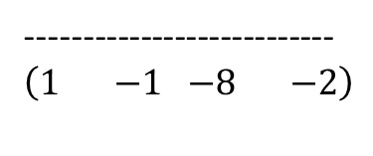
Elementary Row Operations (EROs)
[Example 14]
Multiply the second row by -2 to produce a new second row.
Meaning of Notation
(-2) times Row 2 and then substitute the new entries into Row 2 ("→” means “substitute into”)
Original Matrix
New Matrix
Notation
x (-2)
[Example 15]
Add -2 times the first row to the third row to produce a new third row.
Original Matrix
New Matrix
Notation
x (-2)
$$(\begin{matrix}0 & −2\end{matrix} \begin{matrix}−6 & −4\end{matrix})$$
+
$$(\begin{matrix}1 & 1\end{matrix} \begin{matrix} −2 & 2\end{matrix})$$
---------------------------
$$(\begin{matrix}1 & −1\end{matrix} \begin{matrix} −8 & −2\end{matrix})$$
Meaning of Notation
Row 3 is added to (-2) times Row 1. The new entries are substituted back into Row 3.

Slide 24
Test Yourself:
Elementary Row Operations (EROs)
Matrix A undergoes a single elementary row operation to become matrix B. Describe the elementary row operation involved and write down the notation for each case:
i)
ii)
iii)

Slide 25
Test Yourself:
Elementary Row Operations (EROs)
Matrix A undergoes a single elementary row operation to become matrix B. Describe the elementary row operation involved and write down the notation for each case:
i)

Slide 26
Test Yourself:
Elementary Row Operations (EROs)
Matrix A undergoes a single elementary row operation to become matrix B. Describe the elementary row operation involved and write down the notation for each case:
ii)

Slide 27
Test Yourself:
Elementary Row Operations (EROs)
Matrix A undergoes a single elementary row operation to become matrix B. Describe the elementary row operation involved and write down the notation for each case:
iii)

Slide 28
Application of EROs: Matrix Operations
[Example 16]
Suppose the original matrix equation is shown below:
Pre-Multiplying by identity matrix I
If the original matrix equation is pre-multiplied by the identity matrix on both sides, the matrix equation remains unchanged

Slide 29
Application of EROs: Matrix Operations
Suppose the original matrix equation is as follow:
Observe this matrix. How is it obtained from the identity matrix?
Swapping rows
We observe that this matrix is obtained from identity matrix via EROs
Apply the same EROs in the same order to the original matrix equation

Slide 30
Application of EROs: Matrix Operations
Suppose the original matrix equation is as follow:
Observe this matrix. How is it obtained from the identity matrix?
Multiplying by a row by a non-zero constant
We observe that this matrix is obtained from identity matrix via ERO
Apply the same ERO to the original matrix equation

Slide 31
Application of EROs: Matrix Operations
Suppose the original matrix equation is as follow:
Observe this matrix. How is it obtained from the identity matrix?
Adding a multiple of a row to another row
We observe that this matrix is obtained from identity matrix via ERO
Apply the same ERO to the original matrix equation

Slide 32
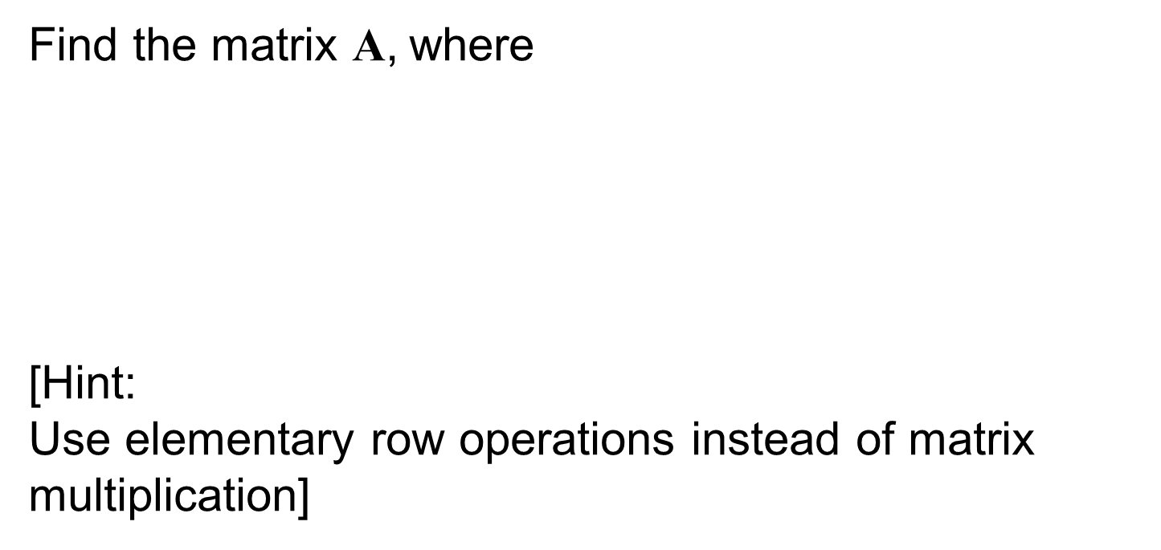
Test Yourself: Matrix Operations
Find the matrix A, where
[Hint:
Use elementary row operations instead of matrix multiplication]

Slide 33
Test Yourself: Matrix Operations

Slide 34
Test Yourself: Matrix Operations

Slide 35
Solving a System of Linear Equations Using Elementary Row Operations (CL)
A system of linear equations can be represented in the augmented matrix form.
This augmented matrix can then be solved by reducing it to the row echelon form using the three elementary row operations.
This method is called “Gaussian elimination with back-substitution”.
Procedures for Gaussian elimination with back substitution:
i. Write down the augmented matrix representing the system of linear equations.
ii. Apply elementary row operations (EROs) to reduce the augmented matrix to the row echelon form.
iii. Write the system of linear equations corresponding to the row echelon matrix, and use back-substitution to find the solution.

Slide 36
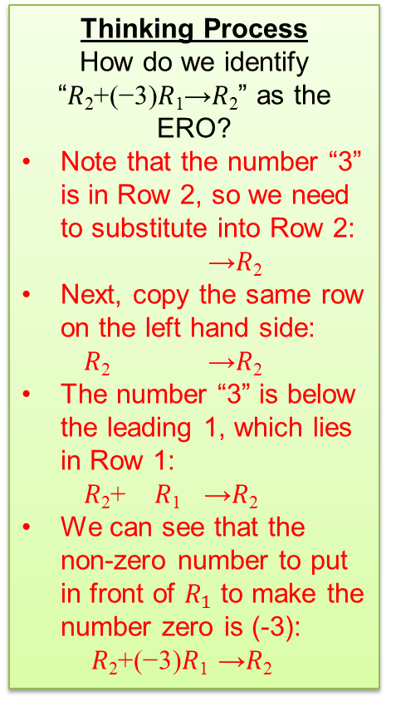
Solving a System of Linear Equations Using Elementary Row Operations (CL)
[Example 17]
Solve the following system of linear equations:
𝑥 −3𝑧 =−2
3𝑥+ 3𝑦 −2𝑧=5
2𝑥+2𝑦 + 𝑧 =4
Thinking Process
How do we identify “𝑅₂+(−3)𝑅₁→𝑅₂” as the ERO?
Note that the number “3” is in Row 2, so we need to substitute into Row 2:
→𝑅₂
Next, copy the same row on the left hand side:
𝑅₂ →𝑅₂
The number “3” is below the leading 1, which lies in Row 1:
𝑅₂+ 𝑅₁ →𝑅₂
We can see that the non-zero number to put in front of $R_{1}$ to make the number zero is (-3):
𝑅₂+(−3)𝑅₁ →𝑅₂
[Solution]
Step 1 – Write down the augmented matrix
Step 2 – Apply elementary row operations to obtain the
row echelon matrix
Let’s begin by applying ERO to reduce this number to “0”.

Slide 37
Solving a System of Linear Equations Using Elementary Row Operations (CL)
Step 2 – Apply elementary row operations to obtain the row echelon matrix
Apply E.R.O. to make this a leading 1
Now, we need to make this number a zero using similar ERO.
The numbers below leading 1 in first row are now reduced to zeroes.
R₃ + (–2)R₁→ R₃
This entry in the second row is a leading 1 now.
Apply E.R.O. to reduce this entry below leading 1 to zero
R₃ + (–2)R₂→ R₃
Apply E.R.O. to make this a leading 1
This entry in the second row is a leading 1 now.
Row Echelon Matrix

Slide 38
Solving a System of Linear Equations Using Elementary Row Operations (CL)
Step 3 – Apply back-substitution to solve for x, y and z.
Row echelon form makes it easy to solve for the first unknown!

Slide 39
Example:
Solving 3 × 3 Matrix Equations (CL)
[Example 18]
Reduce to row echelon form.
Hence, solve for x, y, z in terms of a.
[Solution]
Step 1 – Write down the augmented matrix

Slide 40
Example:
Solving 3 × 3 Matrix Equations (CL)
Step 2 – Apply elementary row operations to obtain the row echelon matrix
R₂ + (–2)R₁→ R₂
R₃ + (–5)R₂→ R₃
Row Echelon Matrix

Slide 41
Example:
Solving 3 × 3 Matrix Equations (CL)
Step 3 – Apply back-substitution to solve for x, y, z.
z=2a
y−7z=−13a
⇒ y =−13a+7z
⇒ y =−13a+7(2) a = a
x+2z=3a
⇒x=3a−2z
⇒x=3a−2(2a)=−a
The solution is x = −a, y = a, z = 2a.

Slide 42
One-minute write
Instruction for lecturers: please copy the correct link and put it in the yellow box in the next slide for your IS class:
https://todaysmeet.com/LRE2-Day3
https://todaysmeet.com/LRE4-Day3
https://todaysmeet.com/LRW3-Day3
https://todaysmeet.com/LRW5-Day3
https://todaysmeet.com/LRE5-Day3
https://todaysmeet.com/LRE2-Day4
https://todaysmeet.com/LRE4-Day4
https://todaysmeet.com/LRW3-Day4
https://todaysmeet.com/LRW5-Day4
https://todaysmeet.com/LRE5-Day4
https://todaysmeet.com/LRE2-Day1
https://todaysmeet.com/LRE4-Day1
https://todaysmeet.com/LRW3-Day1
https://todaysmeet.com/LRW5-Day1
https://todaysmeet.com/LRE2-Day2
https://todaysmeet.com/LRE4-Day2
https://todaysmeet.com/LRW5-Day2
https://todaysmeet.com/LRW3-Day2

Slide 43
One-minute write
Instruction for lecturers: please copy the correct link and put it in the yellow box in the next slide for your IS class:
https://todaysmeet.com/LRE2-Day5
https://todaysmeet.com/LRE4-Day5
https://todaysmeet.com/LRW3-Day5
https://todaysmeet.com/LRW5-Day5

Slide 44
One-minute write
Please stop what you are doing and produce a written response to either of the following in only one minute:
Identify what is the key learning concepts from the seminar, or
Write down a question with respect to the concepts learnt so far.
Link:

Slide 45
Key Learning Objectives
Model real-world (Linear system) applications using matrices.
Solve matrix equations using algebraic properties of matrices (addition, subtraction and multiplication on matrices).
Solve 2x2 matrix equations using the inverse of matrices.
Manipulate matrix equation using basic row operations to reduce it to identity matrix.
Rewrite set of linear equations in matrix form.
Solve 3x3 matrix equations using basic row operations. (CL)

